Slide 1
DevOps & CI/CD
in Cloud Computing
Principles, pipeline architecture, and practical implementation
CSA1507 - CLOUD COMPUTING FOR BIG DATA ANALYSIS
Presented by:
Guided By :
Dr. C. Anuradha
Narmatha .J (192521341)
Lakshna Sree . T. S (192524059)
S. Susannal Devapriyam (192525398)

Slide 2
What is DevOps?
A culture and set of practices that unify software development (Dev) and IT operations (Ops)
Collaboration
Automation
Breaks down silos between developers, testers, and operations teams.
Automates build, test, and deployment steps to remove manual bottlenecks.
Continuous Improvement
Shared Responsibility
Uses feedback loops and monitoring to iterate rapidly and reliably.
Teams jointly own reliability, security, and speed of delivery.

Slide 3
The DevOps Lifecycle
An infinite loop of planning, building, and operating
Plan
Monitor
Code
DevOps
Operate
Build
Deploy
Test
Release

Slide 4
What is CI/CD?
Continuous Integration (CI)
Continuous Delivery / Deployment (CD)
Continuous Integration is the practice of frequently merging code changes into a shared repository, where the code is automatically built and tested.
How it works:
A developer writes code.
The code is pushed to a Git repository (such as GitHub).
A CI tool automatically:
Builds the application.
Runs automated tests.
If all tests pass, the code is ready for the next stage.
Continuous Delivery ensures that software is always ready to be released. After CI completes successfully, the application is prepared for deployment, but a manual approval is usually required before releasing it to users.
Benefits:
Faster releases.
Lower deployment risk.
Reliable release process.

Slide 5
CI/CD Pipeline Architecture
A typical automated pipeline from commit to production
Source
Build
Test
Package
Deploy
Monitor
Code pushed to Git repo
Compile & package app
Unit & integration tests
Create deployable artifact
Release to cloud env
Observe & alert in prod
Version Control
Infrastructure as Code
Automated Testing
Container Orchestration
Cloud role: cloud platforms (AWS, Azure, GCP) provide elastic build agents, and native pipeline services (CodePipeline, Azure DevOps, Cloud Build) that scale pipelines on demand.

Slide 6
The DevOps Toolchain
Popular tools mapped to each pipeline stage
Source Control
Git, GitHub, GitLab, Bitbucket
CI/CD Engines
Jenkins, GitHub Actions, GitLab CI, CircleCI, Azure Pipelines
Configuration & IaC
Terraform, Ansible, AWS CloudFormation, Pulumi
Containers & Orchestration
Docker, Kubernetes, Helm, Amazon ECS
Monitoring & Logging
Prometheus, Grafana, ELK Stack, Datadog, CloudWatch

Slide 7
Why It Matters: Benefits
10x
60%
24x
More frequent deployments than traditional release cycles
Faster recovery from incidents with CI/CD rollback tooling
Fewer production failures with automated testing gates
Faster time-to-market for new features and fixes
Higher software quality via consistent automated testing
Better collaboration between development and operations
Scalable, elastic infrastructure aligned with cloud-native design

Slide 8
Practical Example: E-Commerce App on AWS
End-to-end CI/CD implementation using GitHub Actions and AWS
1. Commit & Trigger
Developer pushes code to GitHub; a GitHub Actions workflow triggers automatically on push to main.
2. Build & Test
Workflow installs dependencies, runs unit tests, and builds a Docker image of the application.
3. Push to Registry
Tested image is tagged and pushed to Amazon Elastic Container Registry (ECR).
4. Deploy to Cloud
AWS CodeDeploy (or ECS rolling update) pulls the new image and deploys it to an ECS Fargate cluster.
5. Monitor & Rollback
Amazon CloudWatch tracks health metrics; a failed health check auto-triggers rollback to the last stable version.

Slide 9
Challenges & Best Practices
Common Challenges
Best Practices
Cultural resistance to cross-team collaboration
Legacy systems that resist automation
Security integration ("shift-left") slows initial adoption
Managing pipeline complexity at scale
Tool sprawl across teams and environments
Start small: automate one pipeline stage at a time
Adopt Infrastructure as Code for repeatable environments
Bake security scans into the pipeline (DevSecOps)
Use feature flags for safer, gradual rollouts
Track DORA metrics to measure real progress

Slide 10
Key Takeaway
DevOps + CI/CD turn cloud infrastructure into a continuous, reliable delivery engine.
Automate relentlessly. Measure everything. Ship with confidence.

Slide 11
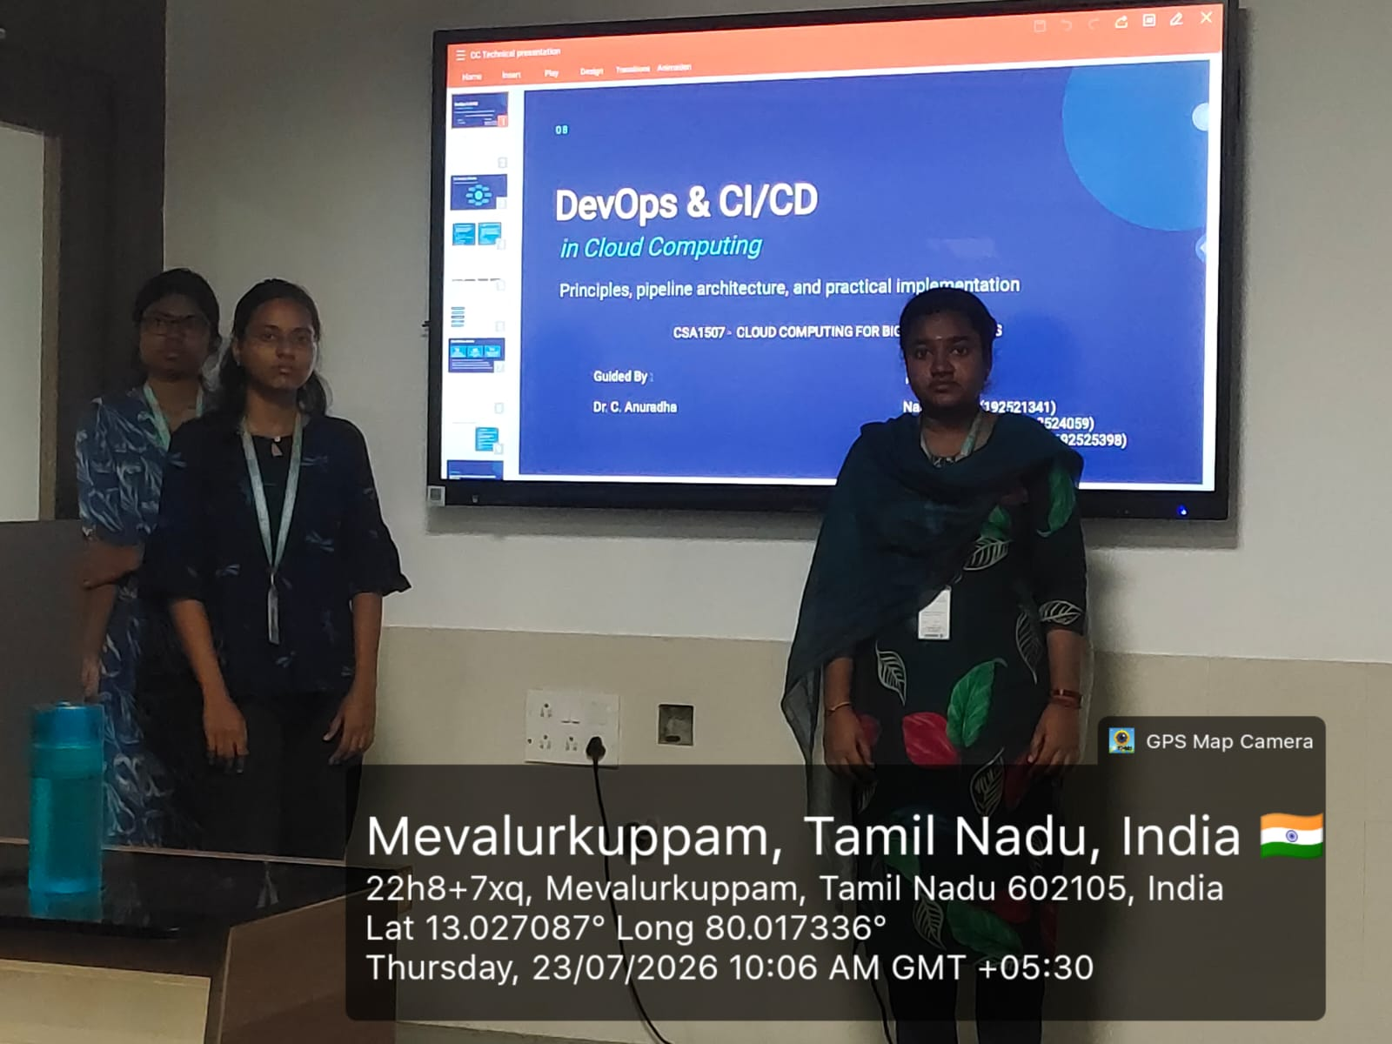
GEOTAG PHOTO

